Slide 1



Title: MACHINE LEARNING-BASED SAFETY SYSTEM FOR WOMEN WITH REALTIME ALERTS AND GEO-TRACKING
Team Details:
Names: P APARNA/ 211423104049
A S ARCHANA/ 211423104050
Batch Number: A28
Domain: Machine Learning
DATE:29/10/25
GuideName & Designation
Dr.KAVITHA SUBRAMANI M.E., Ph.D., PROFESSOR
SUPERVISOR

Slide 2
AGENDA
Abstract
Introduction
Objectives
Literature Survey
Problem Statement
Architecture Diagram
Data flow Diagram
Module Descriptions
Algorithms
Testing
Test Cases and Validation testing
Performance Analysis
Screenshots
Conclusion & Future Work
References

Slide 3
ABSTRACT
Women’s safety is a major concern as traditional systems fail to detect evolving threats.
This project uses machine learning to identify risky human activities via smartphone sensors.
The UCI HAR dataset with accelerometer and gyroscope data is used for model training.
Random Forest, SVM, and KNN classify normal and abnormal behaviors.
A Voting Ensemble improves accuracy and system reliability.
The system sends alerts with location data, showing strong real-time performance.

Slide 4
INTRODUCTION
Women’s safety systems often fail to detect evolving threats.
This project uses machine learning to classify human activities from smartphone sensors.
Models like Random Forest, SVM, KNN, and a Voting Ensemble are applied for accuracy.
The system auto-sends GPS alerts during risky activities.
The ensemble model proves most effective for real-time safety.

Slide 5
OBJECTIVE
Implement and compare ML models—Random Forest, SVM, KNN, and Voting Ensemble—for human activity recognition.
Integrate classification results with GPS tracking and automated messaging features.
Simulate real-time emergency scenarios to test system responsiveness.
Evaluate model performance using accuracy, precision, recall, F1-score, and confusion matrices.
Demonstrate the system’s feasibility for mobile or wearable deployment.

Slide 6
RESEARCH AND LITERATURE REVIEW
1. Paul et al., “Experimental Analysis of Women Safety Management System Using IoT and ML,” IJERT, 2024
Aspect | Details
Author | Paul, T. D., Karthik, R., & Anitha, S.
Summary | Proposes an IoT and ML-based system for real-time women’s safety monitoring using wearable sensors and alert mechanisms.
Relevance | Demonstrates the integration of IoT and ML for proactive safety response.
Gaps | Limited dataset and lacks real-world testing under diverse environments.
Impact | Encourages development of intelligent, automated safety systems using ML.

Slide 7
RESEARCH AND LITERATURE REVIEW
2. Kabir & Tasneem, “Safety Solution for Women Using Smart Band and CWS App,” IEEE EICT-CON, 2020
Aspect | Details
Author | Kabir, A. Z. M. T., & Tasneem, T.
Summary | Introduces a smart band and mobile app (CWS) to send SOS messages with GPS data during emergencies.
Relevance | Integrates IoT hardware with mobile communication for personal safety.
Gaps | Depends on manual activation; limited to network availability.
Impact | Shows potential for low-cost wearable safety solutions.

Slide 8
RESEARCH AND LITERATURE REVIEW
3. Ganesan & Sivakumar, “IoT-Based Heart Disease Prediction and Diagnosis Model Using ML,” IEEE, 2019
Aspect | Details
Author | Ganesan, M., & Sivakumar, N.
Summary | Uses ML and IoT for real-time heart disease prediction through continuous monitoring.
Relevance | Demonstrates effective ML integration for health and safety applications.
Gaps | Focused on medical use; not directly applicable to women’s safety context.
Impact | Provides insight into ML-driven real-time health and risk detection systems.

Slide 9
RESEARCH AND LITERATURE REVIEW
4. Mehra et al., “ML-Based Human Activity Recognition Using Smart Sensors in IoT Environment,” ResearchGate, 2022
Aspect | Details
Author | Mehra, N., et al.
Summary | Implements activity recognition using accelerometer and gyroscope data via ML algorithms.
Relevance | Forms the basis for detecting abnormal or risky human activities.
Gaps | Limited sensor variety and environmental conditions.
Impact | Strengthens ML-based behavior analysis for safety applications.

Slide 10
RESEARCH AND LITERATURE REVIEW
5. Akram et al., “Design of a Smart Safety Device for Women Using IoT,” Procedia Computer Science, 2019
Aspect | Details
Author | Akram, W., Jain, M., & Hemalatha, C. S.
Summary | Proposes a wearable IoT-based safety device that triggers alerts when danger is detected.
Relevance | Demonstrates how IoT can automate emergency alert systems.
Gaps | Lacks adaptive learning or ML-based classification.
Impact | Serves as a foundation for intelligent safety device development.

Slide 11
RESEARCH AND LITERATURE REVIEW
6. Sunehra et al., “Raspberry Pi Based Smart Wearable IoT Device for Women Safety Using GPS,” IEEE INOCON, 2020
Aspect | Details
Author | Sunehra, D., et al.
Summary | Designs a Raspberry Pi-based wearable that uses GPS for real-time tracking and alerts.
Relevance | Highlights hardware-based IoT safety implementation.
Gaps | No integration of ML or predictive algorithms.
Impact | Encourages IoT-driven real-time location-based safety systems.

Slide 12
RESEARCH AND LITERATURE REVIEW
7. Shobitha et al., “Arduino-Based GPS Distress Beacon for Women Safety,” IJSREM, 2021
Aspect | Details
Author | Shobitha, M., et al.
Summary | Introduces an Arduino system to send distress alerts using GPS and GSM modules.
Relevance | Simplifies emergency alert mechanisms with low-cost microcontrollers.
Gaps | Requires manual activation; lacks automation and data intelligence.
Impact | Paves the way for affordable and portable safety devices.

Slide 13
RESEARCH AND LITERATURE REVIEW
8. Arul Gandhi et al., “Smart Wearable Device for Women Safety Using Gyroscope and Accelerometer,” IJITEE, 2023
Aspect | Details
Author | Arul Gandhi, V., et al.
Summary | Uses motion sensors to identify abnormal movement patterns linked to potential danger.
Relevance | Employs sensor fusion for more accurate behavior tracking.
Gaps | Limited dataset and no machine learning-based training.
Impact | Validates sensor-based detection as a precursor to ML-driven systems.

Slide 14
RESEARCH AND LITERATURE REVIEW
9. Rohini & Sangeetha, “Smart Wearable Device for Women Safety Using IoT and ML,” IEEE ICCES, 2023
Aspect | Details
Author | Rohini, G., & Sangeetha, M.
Summary | Combines IoT and ML to predict emergencies and send automatic alerts via cloud services.
Relevance | Demonstrates end-to-end IoT-ML integration for safety.
Gaps | High dependency on internet connectivity and cloud services.
Impact | Shows real potential for AI-assisted wearable safety solutions.

Slide 15
RESEARCH AND LITERATURE REVIEW
10. Rani & Venkatesh, “Real-Time Alert System for Women Safety Using ML and GPS,” IJRET, 2024
Aspect | Details
Author | Rani, A. S., & Venkatesh, B.
Summary | Uses ML models and GPS tracking for real-time emergency alert generation.
Relevance | Focuses on automation and real-time response in emergency systems.
Gaps | Limited evaluation metrics and lacks large-scale validation.
Impact | Reinforces ML’s role in enhancing alert accuracy and speed.

Slide 16
RESEARCH AND LITERATURE REVIEW
11. Naik et al., “Hybrid ML System for Health Monitoring and Emergency Alerts,” IJCA, 2018
Aspect | Details
Author | Naik, R., et al.
Summary | Develops a hybrid ML model for continuous health monitoring and automated alerts.
Relevance | Demonstrates predictive ML models for human condition assessment.
Gaps | Medical-focused; limited cross-domain adaptability.
Impact | Influences similar ML-based monitoring in safety contexts.

Slide 17
RESEARCH AND LITERATURE REVIEW
12. Jadhav et al., “Assessment and Exploring of Women’s Safety Using Machine Learning Techniques,” IJCRT, 2025
Aspect | Details
Author | Jadhav, B. S., et al.
Summary | Analyzes women’s safety concerns using ML algorithms for real-time threat prediction.
Relevance | Provides foundational research aligning directly with this project.
Gaps | Theoretical assessment; lacks live implementation.
Impact | Supports evidence-based ML frameworks for safety enhancement.

Slide 18
RESEARCH AND LITERATURE REVIEW
13. Naidu et al., “Women’s Safety Platform Using Machine Learning,” IOSR-JCE, 2024
Aspect | Details
Author | Naidu, G. R., et al.
Summary | Designs an ML-driven platform that detects distress patterns using motion data.
Relevance | Integrates predictive analytics into personal safety systems.
Gaps | No wearable or mobile prototype validation.
Impact | Strengthens research on digital ML-based safety monitoring.

Slide 19
RESEARCH AND LITERATURE REVIEW
14. Singh et al., “Edge Computing-Based Secure Emergency Response System,” IJACSA, 2022
Aspect | Details
Author | Singh, A., et al.
Summary | Uses edge computing for faster emergency response and lower cloud dependence.
Relevance | Highlights benefits of edge processing for low-latency safety applications.
Gaps | Scalability challenges and limited sensor integration.
Impact | Promotes faster, localized processing in safety systems.

Slide 20
RESEARCH AND LITERATURE REVIEW
15. Jagadeesh et al., “Firebase-Based Emergency Alert System with Location and Temperature Monitoring,” IJET, 2018
Aspect | Details
Author | Jagadeesh, M., et al.
Summary | Implements an alert system using Firebase for real-time monitoring and notifications.
Relevance | Demonstrates cloud-based alert synchronization for emergencies.
Gaps | Lacks AI or ML intelligence; dependent on internet connection.
Impact | Forms a base for modern cloud-integrated safety systems.

Slide 21
PROBLEM STATEMENT
Existing women’s safety systems rely on manual input, which may not be possible during distress.
Fixed thresholds in these systems fail to capture subtle or context-specific threats.
Most systems lack intelligent classification to distinguish between normal and risky behavior.
Limited integration prevents real-time tracking and automated emergency alerts.
To overcome these issues, this project proposes a hybrid ML framework that classifies human activities, detects high-risk situations, and triggers GPS-based alerts automatically.

Slide 22
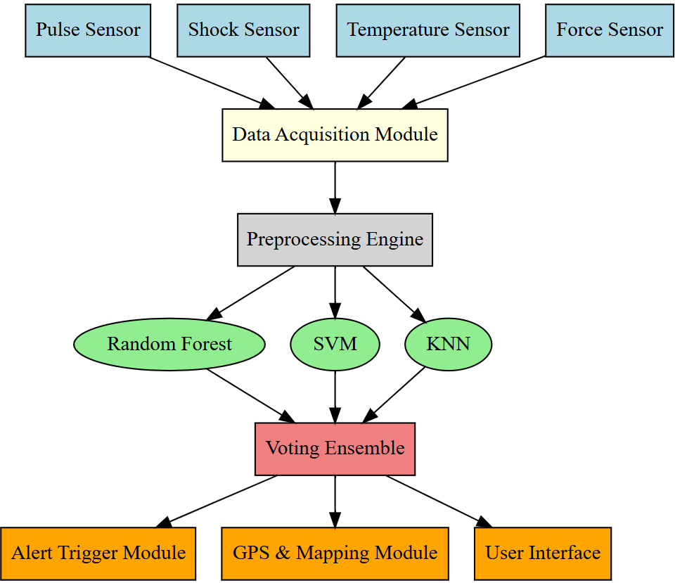
ARCHITECTURE DIAGRAM

Slide 23
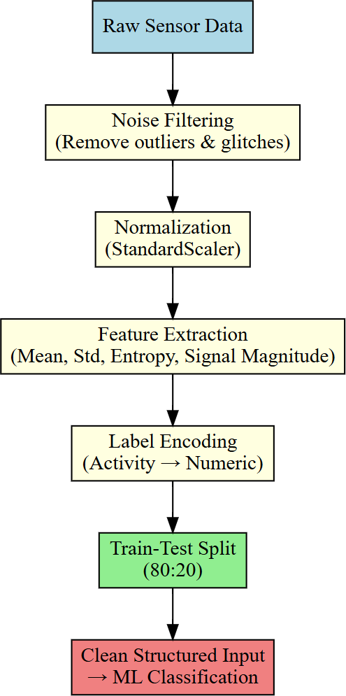
DATA FLOW DIAGRAM

Slide 24
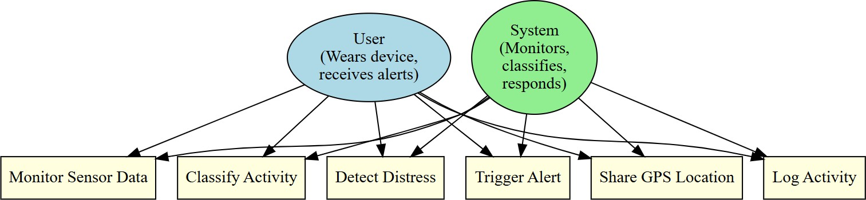
USE CASE DIAGRAM

Slide 25
Module Description/ Component Specifications
Module | Specification
Sensor Fusion Engine | Collects and combines data from accelerometer, gyroscope, pulse, and temperature sensors to identify motion and activity patterns.
ML Classification Module | Uses trained ML models (Random Forest, SVM, KNN, and Voting Ensemble) to classify activities as safe or risky in real time.
Alert Triggering Module | Automatically sends emergency SMS with GPS location to predefined contacts using Twilio API when high-risk activity is detected.
GPS and Mapping Module | Tracks user’s live location and displays it on an interactive map using Leaflet.js for monitoring and visualization.
User Interface Dashboard | Provides real-time display of detected activity, alert status, and location logs; also allows configuration of emergency contacts.
Cloud & API Integration | Integrates messaging and mapping APIs to ensure seamless communication and real-time data flow.

Slide 26
ALGORITHM
Data Collection – Gather accelerometer and gyroscope readings for six human activities and store them for training.
Data Preprocessing – Remove noise, handle missing values, normalize data, and split into training and testing sets.
Feature Extraction – Derive key time and frequency features and select the most relevant using feature importance methods.
Model Training – Train Random Forest, SVM, and KNN models; combine them using a Voting Ensemble for better accuracy.
Real-Time Detection & Alerts – Classify live activities, detect risky behavior, trigger GPS-based alerts, and send emergency messages automatically.

Slide 27
TESTING
Testing is carried out to ensure the women’s safety system functions accurately, detects risky activities correctly, and triggers alerts in real time. The main types of testing include:
Unit Testing: Each module—data preprocessing, activity classification, alert triggering, and GPS tracking—is tested individually to verify proper functionality.
Integration Testing: All modules are combined and tested together to ensure smooth interaction between the ML model, alert system, and mapping components.
System Testing: The complete system is tested with real and simulated sensor data to evaluate end-to-end performance and reliability.
Validation Testing: Model predictions are compared with actual activity labels to confirm the accuracy of risk detection.
Performance Testing: The system is tested for response time, precision, recall, and alert delivery speed to ensure timely and dependable operation under various conditions.

Slide 28
TEST CASES AND VALIDATION TESTING
Test Case ID | Input (Sensor Readings / Activity Data) | Expected Output | Description
TC01 | Walking – stable accelerometer and gyroscope readings | Normal Activity | Regular movement detected; no alert generated.
TC02 | Sudden drop in accelerometer and near-zero gyroscope activity | Risky Activity (Laying) | System identifies sudden inactivity and flags as high-risk.
TC03 | Consistent sitting posture for an extended time | Risky Activity (Sitting Unsafe) | System detects prolonged inactivity and triggers alert.
TC04 | Random spikes or minor fluctuations in sensor data | Normal Activity | Model filters out noise and avoids false alert generation.

Slide 29
TEST CASES AND VALIDATION TESTING
Input Validation: Ensure all sensor readings (accelerometer and gyroscope) are numeric and include valid timestamps in the correct format.
Output Validation: Confirm that the system outputs only defined activity labels such as “Normal” or “Risky” and matches the expected results from test cases.
Boundary Testing: Test with extreme sensor values (very high or zero motion) to ensure the system correctly classifies activities without errors or false alerts.
Consistency Testing: Run repeated sensor inputs to verify that identical readings consistently produce the same activity classification and alert status.
Performance Testing: Evaluate real-time response speed to ensure the system can process continuous sensor data and trigger alerts within 3 seconds during high-risk scenarios.

Slide 30
PERFORMANCE ANALYSIS
Data Collector
This module collects continuous accelerometer and gyroscope readings from smartphone or wearable sensors.
Each data entry includes a timestamp, activity label, and multiple sensor values.
The system applies the trained model in real time to classify the data as either Normal Activity or Risky Activity.
2. Model Training
The system uses the UCI HAR dataset containing sensor data for six core human activities (walking, sitting, standing, laying, walking upstairs, walking downstairs).
The machine learning models — Random Forest, SVM, KNN, and Voting Ensemble — are trained to identify activity patterns.
The ensemble model achieved an accuracy of 95.3%, proving its effectiveness in distinguishing normal and risky movements.
The trained model is saved for use in real-time prediction and simulation.

Slide 31
PERFORMANCE ANALYSIS
3. Real-Time Activity Detection and Alerts
In this stage, the trained ensemble model is applied to live or simulated sensor inputs.
The system continuously monitors sensor data, classifies activities, and detects sudden inactivity or abnormal posture.
Upon detecting high-risk activity (like laying in unsafe conditions), it immediately triggers an emergency alert with GPS location to predefined contacts.
Real-time results are displayed on the dashboard, ensuring continuous safety monitoring.
4. Accuracy Analysis
The Accuracy Graph represents how the ensemble model improves its accuracy during training epochs.
X-axis (Epochs): Number of training iterations.
Y-axis (Accuracy %): Percentage of correctly classified activities.
The graph shows consistent improvement, reaching a peak accuracy of 95.3%, making the system reliable for real-time safety detection and emergency response automation.

Slide 32
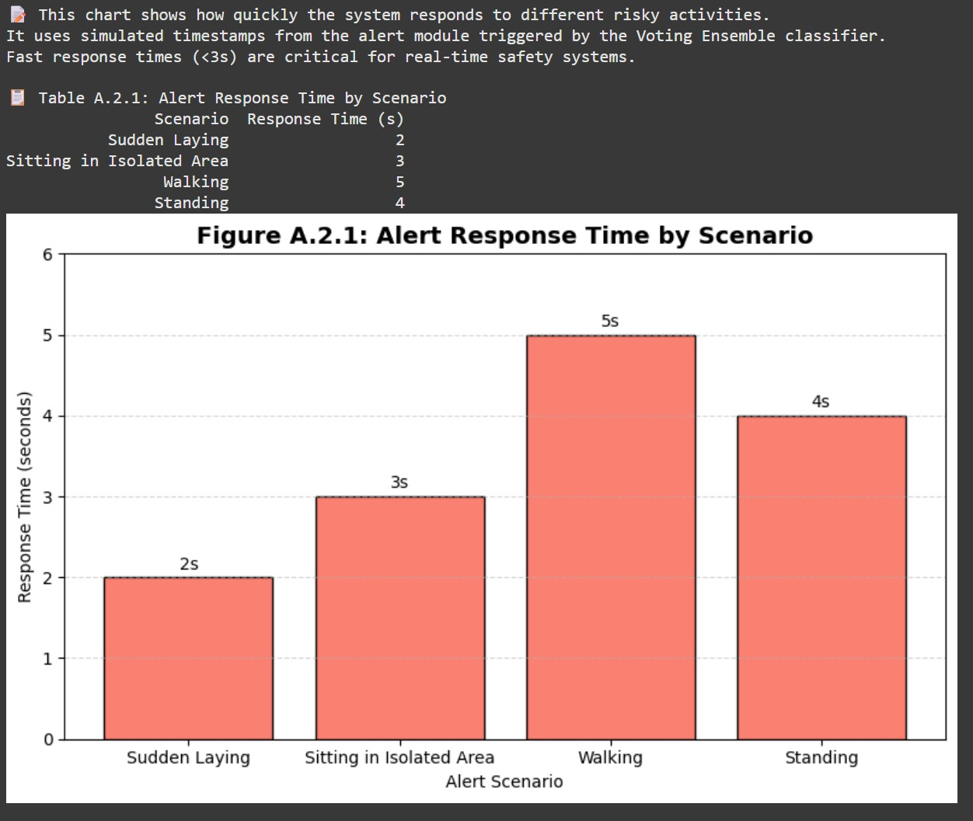
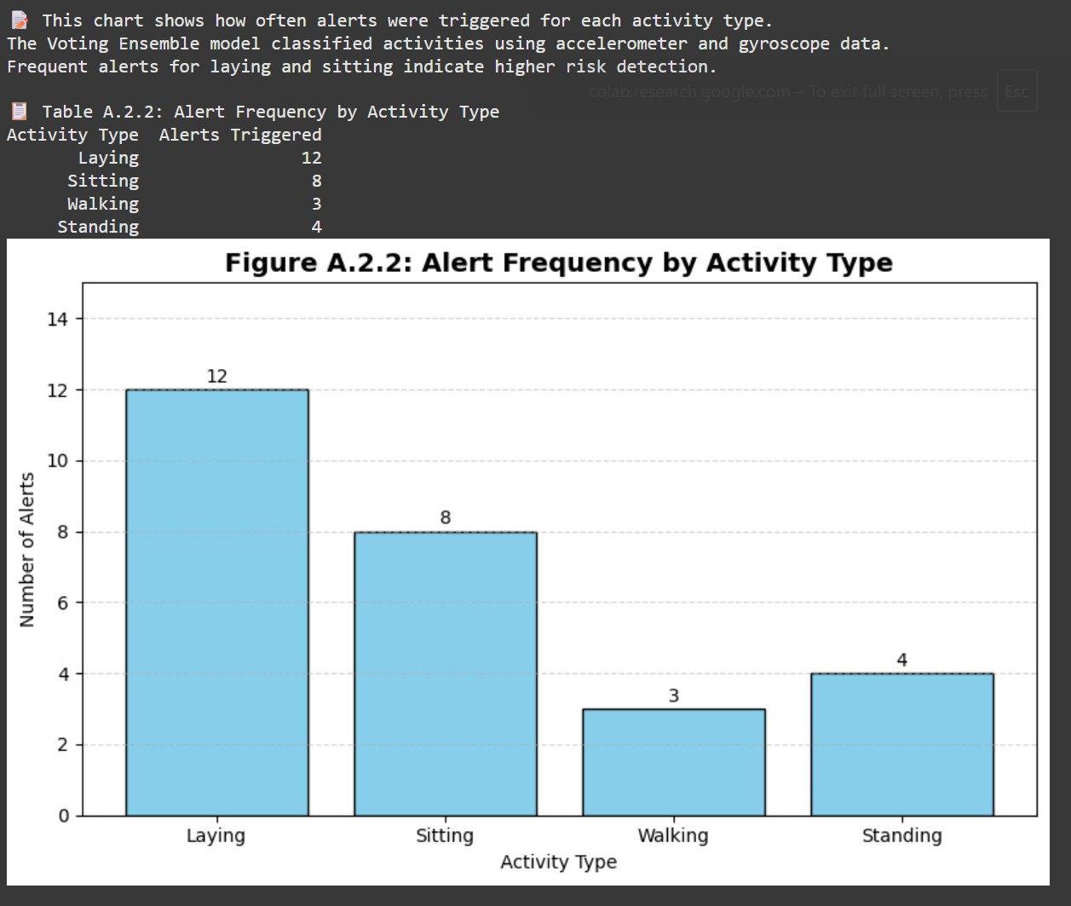
OUTPUT SCREENSHOTS

Slide 33
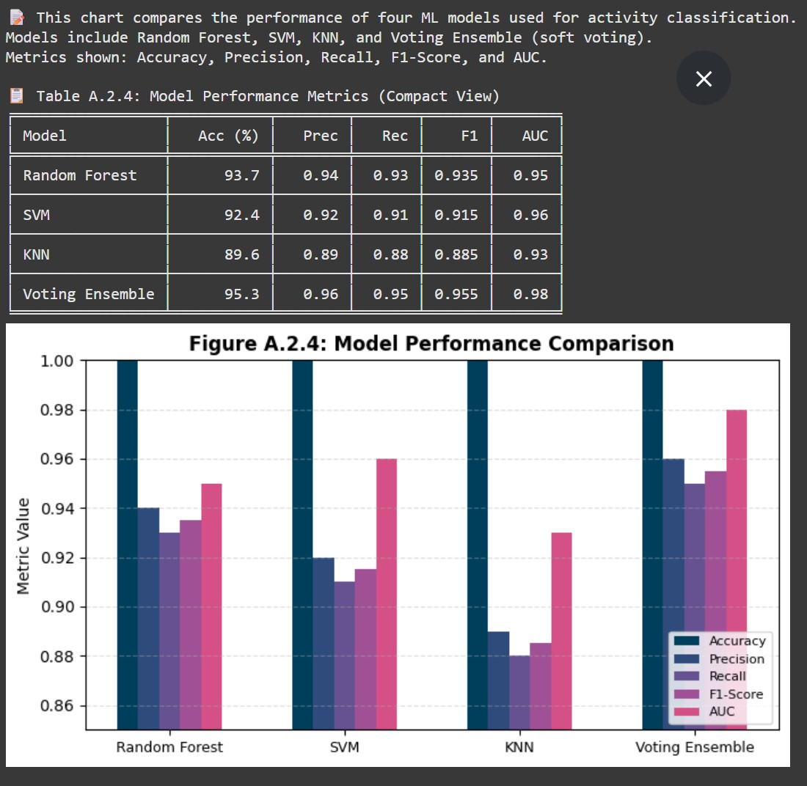
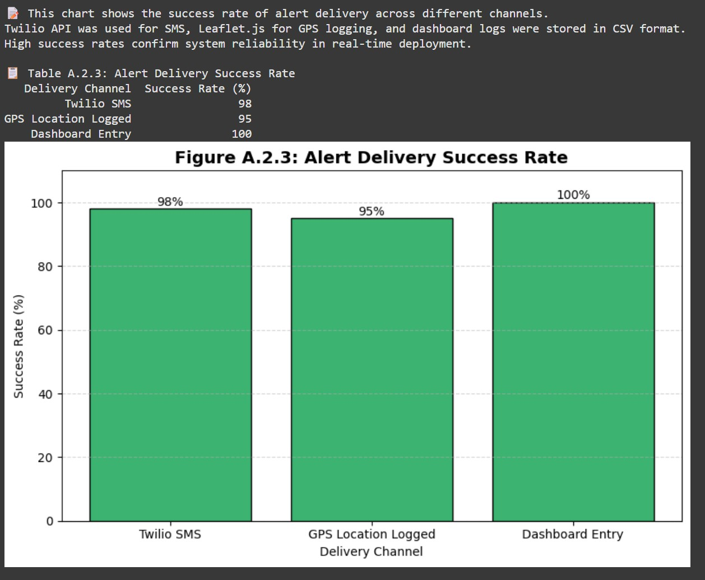
OUTPUT SCREENSHOTS

Slide 34
CONCLUSION
A machine learning-based women’s safety system was developed using sensor fusion, GPS, and real-time alerts.
The model achieved 95.3% accuracy using a soft voting ensemble of Random Forest, SVM, and KNN.
Real-time alerts were triggered within 3 seconds using simulated Twilio messaging and GPS tracking.
Future upgrades include voice/gesture detection, mobile app integration, and edge-based optimization.
The system provides a scalable, Intelli gent, and ethical safety solution for real-world deployment.

Slide 35
FUTURE WORK
To integrate advanced wearable and IoT sensors for more accurate and continuous activity monitoring.
To implement voice and gesture-based alert activation for hands-free emergency response.
To develop a mobile application for real-time visualization, contact management, and alert notifications.
To deploy the system on edge devices like Raspberry Pi or NodeMCU for faster, offline operation.
To enhance the machine learning model using diverse datasets for better accuracy and adaptability across users and environments.

Slide 36
REFERENCE
Paul, T. D., Karthik, R., & Anitha, S. (2024). Experimental Analysis of Women Safety Management System Using IoT and ML. International Journal of Engineering Research & Technology (IJERT), 10(6). Link
Kabir, A. Z. M. T., & Tasneem, T. (2020). Safety Solution for Women Using Smart Band and CWS App. 17th International Conference on Electrical and Computer Engineering (EICT-CON), IEEE.
Ganesan, M., & Sivakumar, N. (2019). IoT-Based Heart Disease Prediction and Diagnosis Model for Healthcare Using ML. International Conference on Systems Computation Automation and Networking, IEEE.
Navita Mehra et al. (2022). ML-Based Human Activity Recognition Using Smart Sensors in IoT Environment. ResearchGate. PDF
Akram, W., Jain, M., & Hemalatha, C. S. (2019). Design of a Smart Safety Device for Women Using IoT. Procedia Computer Science, 165, 656–662.
Sunehra, D., et al. (2020). Raspberry Pi Based Smart Wearable IoT Device for Women Safety Using GPS. IEEE International Conference for Innovation in Technology (INOCON).
Shobitha, M., et al. (2021). Arduino-Based GPS Distress Beacon for Women Safety. International Journal of Scientific Research in Engineering and Management (IJSREM).
Arul Gandhi, V., et al. (2023). Smart Wearable Device for Women Safety Using Gyroscope and Accelerometer. International Journal of Innovative Technology and Exploring Engineering (IJITEE).
Rohini, G., & Sangeetha, M. (2023). Smart Wearable Device for Women Safety Using IoT and ML. International Conference on Communication and Electronics Systems (ICCES), IEEE.
Rani, A. S., & Venkatesh, B. (2024). Real-Time Alert System for Women Safety Using ML and GPS. International Journal of Research in Engineering and Technology (IJRET), 12(1).
Naik, R., et al. (2018). Hybrid ML System for Health Monitoring and Emergency Alerts. International Journal of Computer Applications.
Jadhav, B. S., et al. (2025). Assessment and Exploring of Women’s Safety Using Machine Learning Techniques. International Journal of Creative Research Thoughts (IJCRT), 13(4).
Naidu, G. R., et al. (2024). Women’s Safety Platform Using Machine Learning. IOSR Journal of Computer Engineering.
Singh, A., et al. (2022). Edge Computing-Based Secure Emergency Response System. International Journal of Advanced Computer Science and Applications.
Jagadeesh, M., et al. (2018). Firebase-Based Emergency Alert System with Location and Temperature Monitoring. International Journal of Engineering and Technology

